Slide 1
Reflectometry and SANS
Mantid 2019

Slide 2
Road Maps
2D detectors – reflectometers
SESANS
POLARIS (D33 and ZOOM)
Auto Reduction
Web Reduction
IDAAS

Slide 3
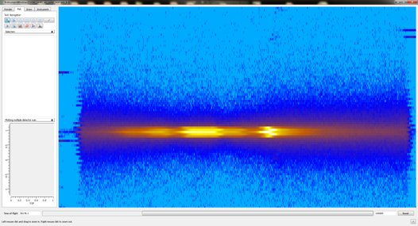
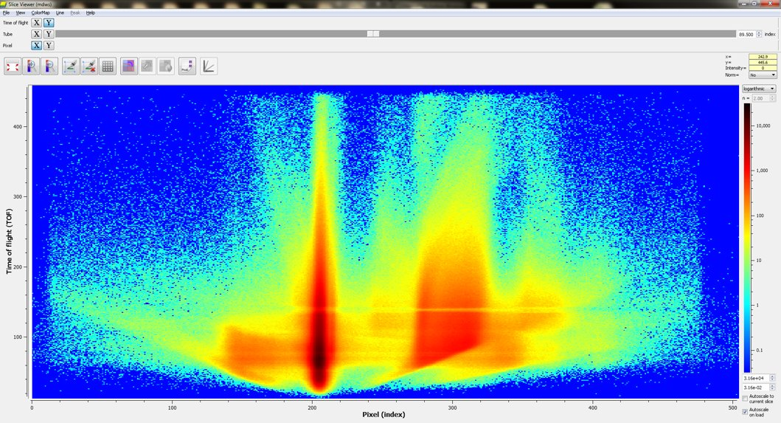
New SliceViewer or Similar
Reflectometry needs some more flexible tool for looking at 3D data (2D + time)
SANS Would find this potentially useful too
RoI's Background regions, more flexible masks

Slide 4
Mantid 4.0 and other things
Still too "young" for fully formed opinions from this group
ISIS SANS GUI just ported
View is largely positive but currently have few issues stopping use
NR GUI not ported
Sliceviewer used a lot in NR – need to define required basic functionality
Ideas for instrumentView mask/RoI improvements
Movable masks?
Multi RoI's? - Possible overlap with fiber diffraction?
Subscriptions for new features by technique (newsletter or so via github pull requests)

